Slide 1
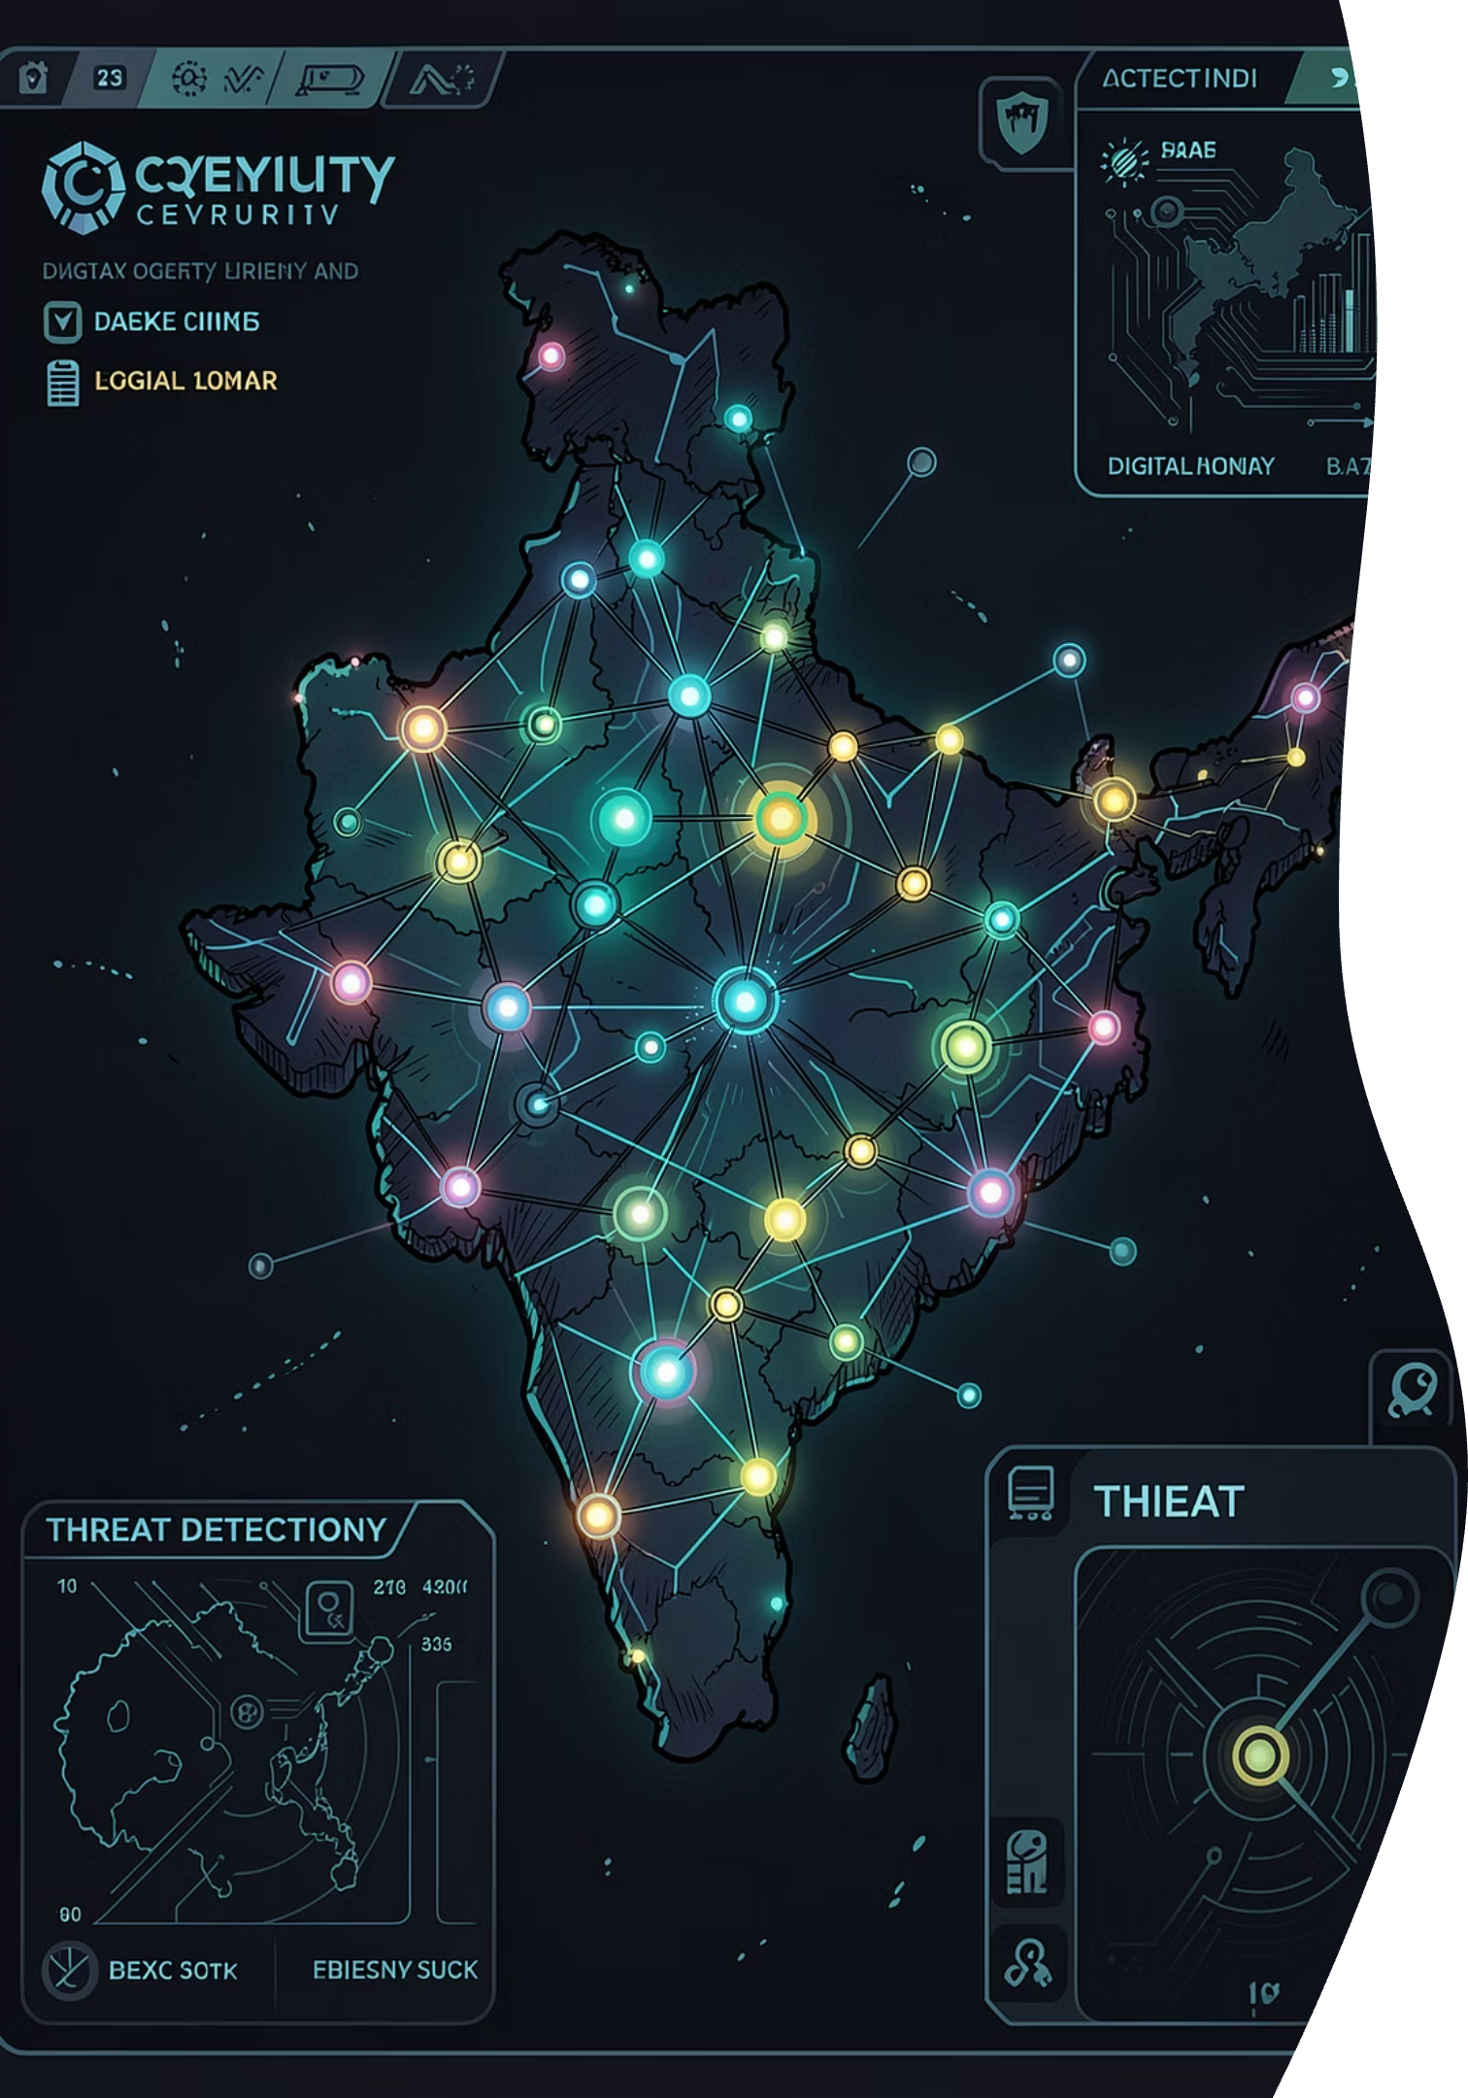
AI-POWERED FRAUD PREVENTION
GuardIndia AI
Securing India's Digital Lending Stack
Standard e-KYC verifies if an identity exists. GuardIndia AI verifies if the applicant is a real, organic human — or a synthetic factory clone. Built for instant micro-lenders, fintechs, and credit ecosystems on India's DPI stack.

Slide 2
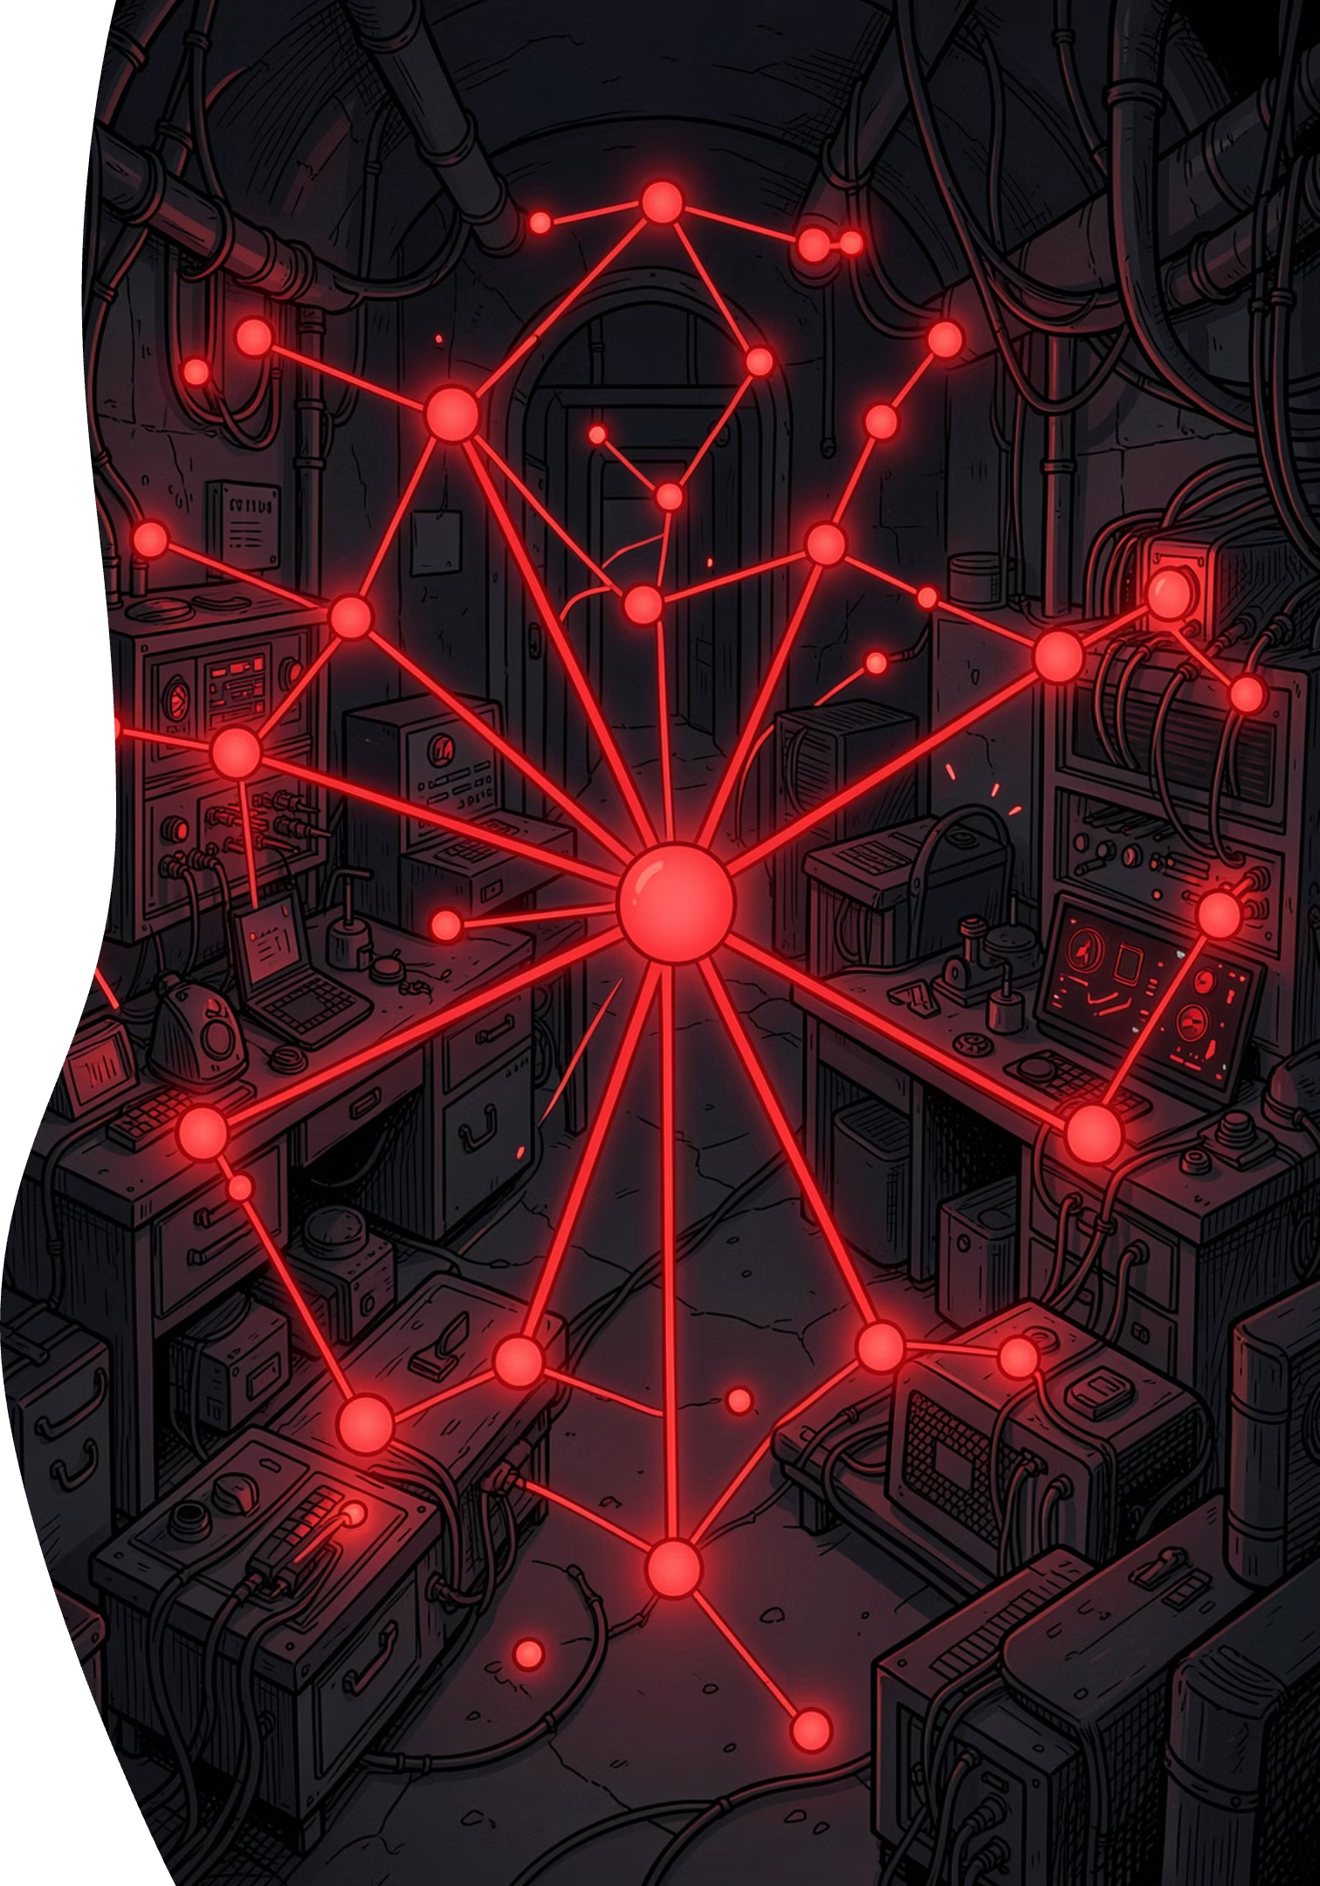



THE THREAT
The Invisible Bust-Out Threat
Fraud syndicates combine dark web breaches (valid Aadhaar/PAN) with burner SIMs and generative AI to create high-quality fake KYC cards and deepfake camera streams. Because these profiles contain partially valid registry data, they pass standard compliance gates — and then systematically exploit the lending ecosystem.
The Exploit
Dark web breaches (valid Aadhaar/PAN) combined with burner SIMs and generative AI create high-quality fake KYC cards and deepfake camera streams.
Incubation Phase
Profiles pass standard compliance gates, take micro-loans, and repay on time over 60–90 days to inflate CIBIL scores above 700.
Coordinated Payout
Automated scripts execute synchronized withdrawals across multiple platforms simultaneously, siphoning cash before bureaus can sync.

Slide 3

THE PARADIGM SHIFT
Compliance is Not Security
Compliance Check (Static)
GuardIndia Security (Dynamic)
Does PAN ABCDE1234F exist?
Result: Yes → Approved
Static verification confirms registry presence but cannot detect synthetic identity networks or coordinated fraud.
Does the relationship between this PAN, phone, device fingerprint, and behavioral biometrics indicate organic human ownership?
Result: Flagged
Dynamic analysis evaluates the full identity graph, catching synthetic profiles that pass static checks.
Core Value Proposition: A real-time, 4-layer threat assessment pipeline that links identity graphs, validates document integrity, binds device hardware, and analyzes interactive biometrics — before loan disbursal.

Slide 4
DEFENSE ARCHITECTURE
4-Layer Defense Architecture
How GuardIndia AI stops synthetic fraud — layer by layer, before a single rupee is disbursed.
1
2
Identity Graph Audit
Document Integrity
NetworkX — Maps PANs, phone numbers, and names into mathematical nodes. Computes Jaccard coefficients to check if new relationships deviate from historically established registry patterns.
OpenCV — Error Level Analysis (ELA) detects photo/text alterations. Moiré FFT detects screen-reproduced cards. Photometric Liveness flashes random screens to check for 3D skin reflectance, blocking virtual camera and video feed injections.
3
4
Device Fingerprinting
Behavioral Biometrics
WebGL + Isolation Forest — Renders a silent 3D graphic. GPU rendering variations generate a hardware-unique signature, isolating emulator farms and multi-account browser rigs.
Random Forest — Monitors live telemetry (mouse path variance, typing cadence, clipboard pastes). Robotic scripts interact with absolute velocity/precision, producing high anomaly ratings.

Slide 5
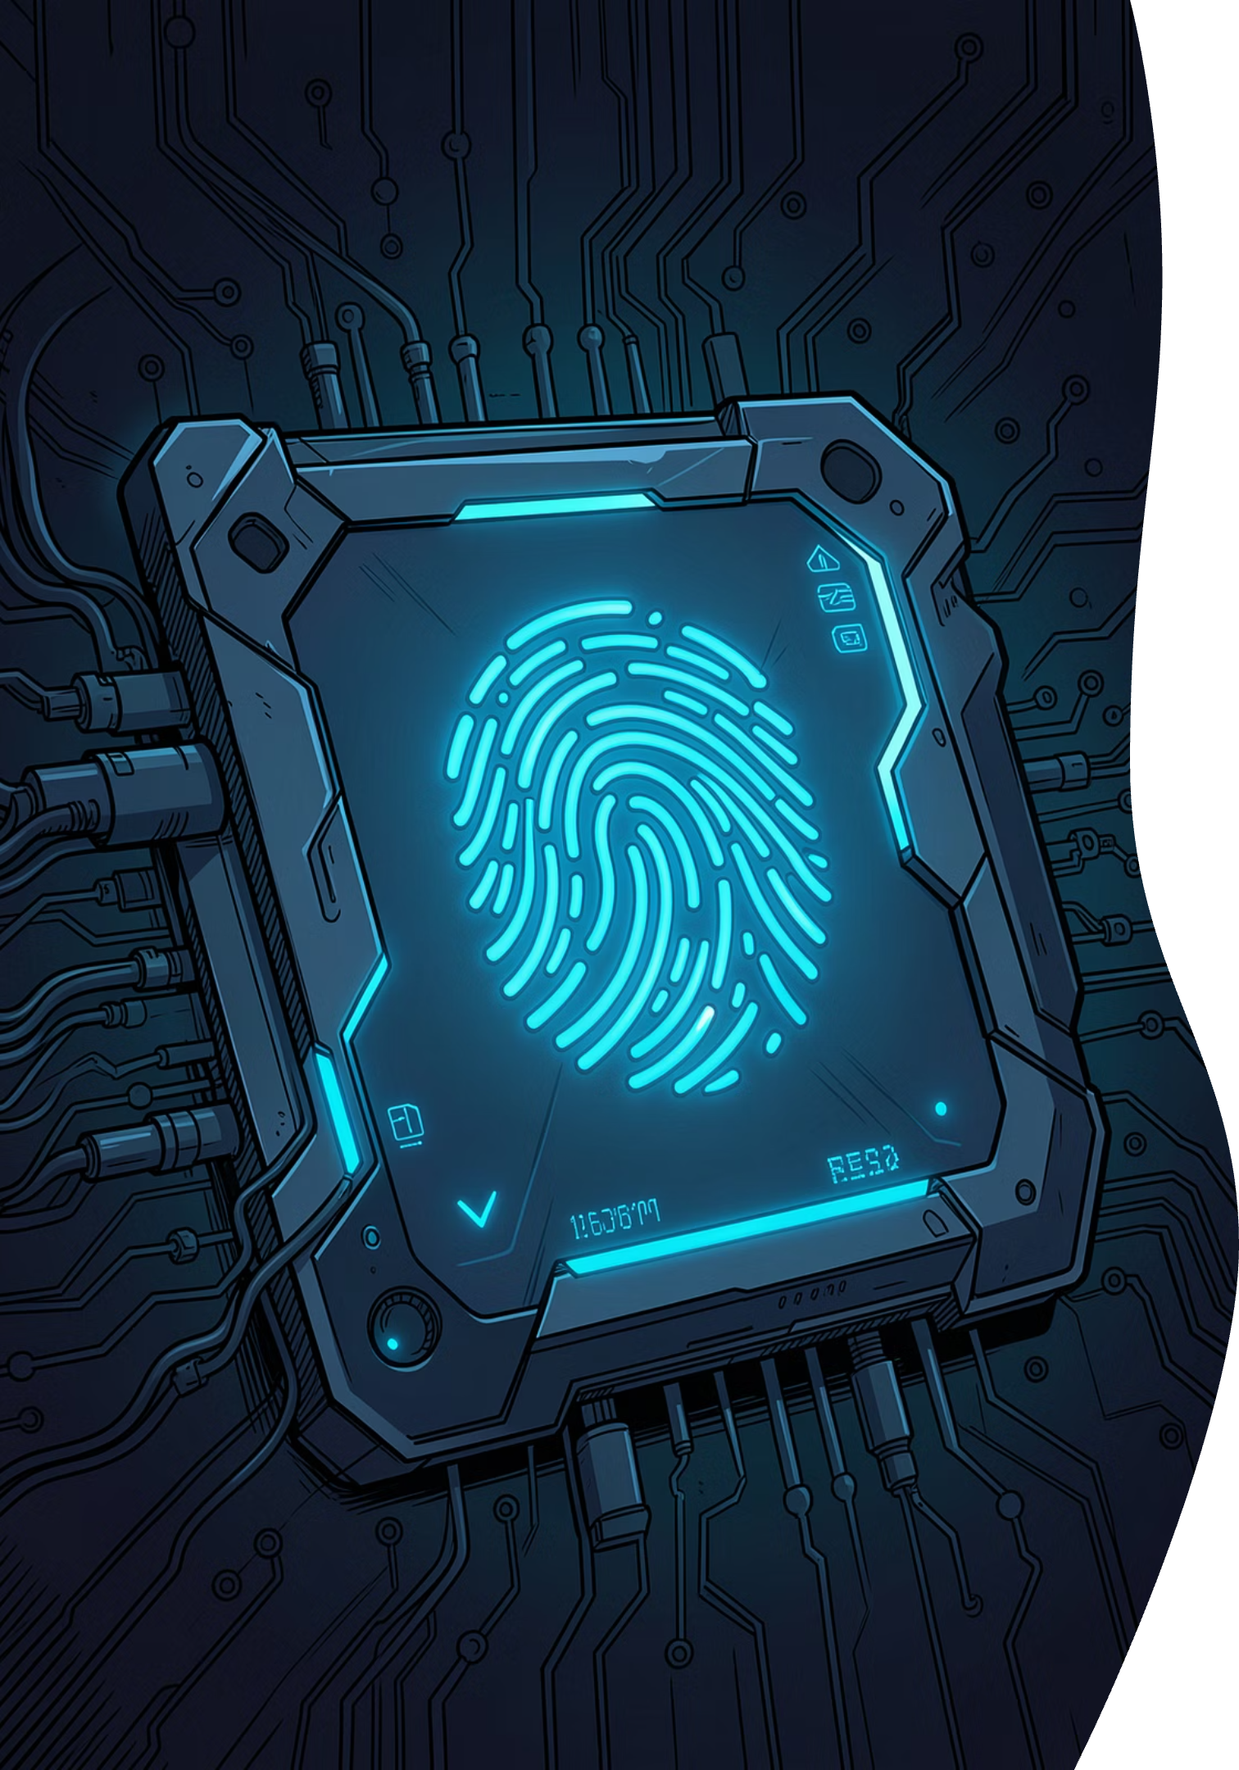
INNOVATION
Advanced Safeguards for Fintech
TPM Passkey Binding
Binds the user session directly to the physical device's Secure Enclave using WebAuthn. Replaces weak carrier-SIM checks with hardware-backed credentials that cannot be spoofed or ported.
Stateful Circuit Breakers
Ensures 100% platform uptime. If heavy ML model servers or LLM APIs encounter lag or failure, the system falls back instantly to local deterministic rules — CLOSED ⇆ OPEN states with zero downtime.
AI Analyst Copilot
Synthesizes complex telemetry data into plain-English threat narratives using LLMs, empowering manual underwriters to review and act on decisions instantly without ML expertise.

Slide 6
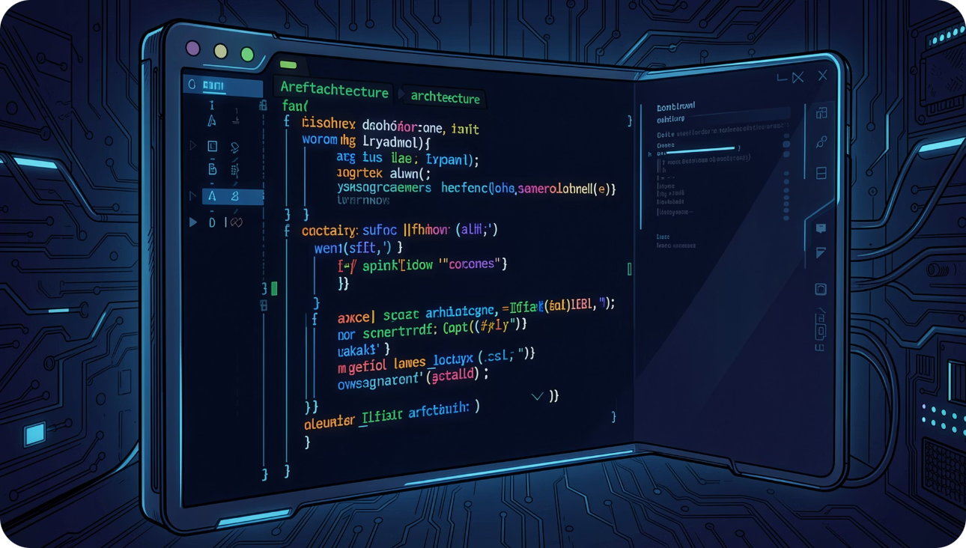
TECH STACK
High-Performance, Zero-Blocking Pipeline
Frontend Tracker
React, Vite, WebGL GPU Shader, WebAuthn
Backend Engine
FastAPI (using background tasks for zero-blocking visual analysis), SQLite (relational records), SQLAlchemy
ML & Analytics Engine
scikit-learn (Isolation Forest for device telemetry; Random Forest for biometrics)
OpenCV (Computer Vision for ELA scan / Moiré FFT)
NetworkX (Mathematical Graph Linkage)
API Decision Layer
Gemini API / LLM-based Copilot reporting

Slide 7

ROADMAP
Built for Scale, Ready to Deploy
Phase 1 — Prototype
1
Current — Working full-stack React and FastAPI dashboard with live trackers, model inference pipelines, and mock databases.
2
Phase 2 — Integration
Exposing API endpoints for easy plug-and-play middleware integration with existing lending apps.
Phase 3 — Consortium Registry
3
Shared WebGL fingerprint database. If a hardware hash is flagged on Lender A's platform, the signature is updated ecosystem-wide, blocking Lender B bust-outs.
Security Feasibility: Low latency overhead. High-resource checks run asynchronously in background workers, keeping onboarding time under 15 seconds.

Slide 8

THE ADVANTAGE
The GuardIndia Advantage
Zero Human Friction
Proactive Prevention
Real human applicants experience no complex captchas or intrusive authentication. Legitimate users flow through onboarding seamlessly.
Blocks fraud syndicates during onboarding and incubation — before credit siphoning can occur. Prevention, not recovery.
DPI Integration
Integrates into Aadhaar, PAN, and UPI ecosystems, acting as a security firewall for modern digital lending apps across India.
GuardIndia AI doesn't just check identities — it defends the entire digital lending ecosystem against the next generation of synthetic fraud.

